Slide 1
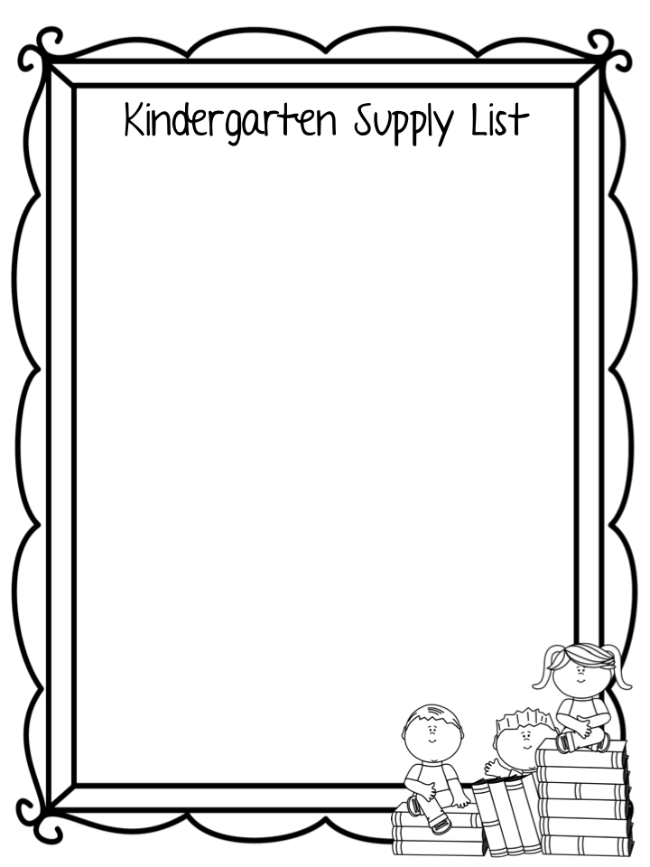
2024-2025
1 plastic pencil box
2 boxes of 24 count crayons
1 pack of #2 pencils
6 large glue sticks
1 pair of scissors (round tip)
2 packs of white index cards (3x5 inch)
1 box of tissues
1 box of zip lock bags (quart or gallon)
2 bottles of hand sanitizer
1 rest mat with a small blanket
1 pack of copy paper
1 pair of headphones (no ear buds)
Please label your child’s rest mat.
Please buy extra crayons, scissors, pencils and glue for home. Children will need them for homework.
Please no rolling book bags.
Send a full change of clothes to keep in your child’s cubby.

